Slide 1



School of Electronics Engineering (SENSE)
MTech VLSI design
Analysis of ECG Signals through Lossless Compression
Techniques for Enhanced Data Management
Presented by :-
Abhishek Patnaik (23MVD0049)
Guided by :-
Dr. Prachi Sharma

Slide 2

Introduction
Research targets wearable sensor nodes' data storage and power challenges during long-term
biomedical signal monitoring in wireless body area networks (WBANs).
Proposes a hybrid lossless compression using Run-length and Golomb–Rice coding
to enhance Compression Ratio (CR) and alleviate power consumption concerns.
Successful implementation on MIT-BIH arrhythmia database demonstrates a compression ratio of 2.91,
reducing data size without compromising ECG integrity.
Developed VLSI-based architecture in 90nm CMOS achieves low power consumption (18.78 µW)
and small footprint (0.0051 mm2), advancing efficiency in wireless body area networks.

Slide 3
Literature Review:
Author(s), Year
Aim of Paper
Key findings
Fahimeh Nasimi,Yee Wei Law ,
2020
“Exploiting similar prior knowledge for compressing ECG signals”
Achieved 99.9% accuracy with 25 compression ratio.
Low PRD (<10) in MIT-BIH Long Term Database.
Effective for heart rate variability analysis.
Shu-Yen Lin, Hao-Te Lin, 2018
“Lossless and Lossy Direct Compression Design With Multi-Signal Symptom Detection for Low-Temperature Wearable Devices”
LLDC applies to ECG, BP, and RESP.
Detects abnormalities, adjusts compression dynamically.
Reduces power, temperature in wearable devices.

Slide 4
Author(s), Year
Aim of Paper
Key findings
“A 2.63 μW ECG Processor With Adaptive Arrhythmia Detection and Data Compression for Implantable Cardiac Monitoring Device”
Ultra-low power ASIC for cardiac monitoring.
Adaptive arrhythmia detection with high precision.
Efficient ECG compression (CR 17.0).
Yue Yin, Syed Muhammad Abubakar,
2021
Tsung-Han Tsai; Nai-Chieh Tung, 2021
“VLSI Implementation of Multi-Channel ECG Lossless Compression System”
Multi-channel ECG compression with adaptive prediction.
Golomb rice code for efficient entropy coding.
Low-power TSMC 180nm implementation (69.18μW, 1 KHz).
Tsung-Han Tsai; Muhammad Awais Hussain , 2020
“VLSI Implementation of Lossless ECG Compression Algorithm for Low Power Devices”
VLSI achieves efficient ECG compression.
Memory-less design for storage efficiency.
Achieves 2.77 bit compression rate.

Slide 5
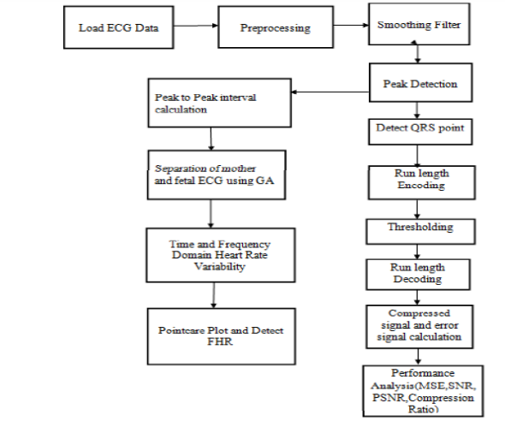
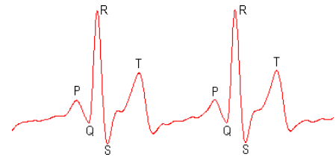
Architecture Diagram:

Slide 6

Problem Statements
Problem centers on efficiently compressing ECG signals in wearable healthcare devices.
Emphasis on low-power design requires effective compression algorithms preserving
critical information.
Challenge involves developing methods to substantially reduce ECG data bit size.
Aim is to optimize wearable sensor nodes for extended battery life and efficiency.

Slide 7
Objectives
1
The objective of the VLSI-Based Hybrid ECG Compression Scheme for Wearable Sensor Node is to propose a hybrid lossless compression algorithm that combines Run-length coding and Golomb–Rice coding.
2
Design caters to low-power wearable devices, offering a resource-efficient solution.
3
This innovation contributes to the field of engineering, medicine, and computer science by improving the efficiency of data transmission and storage in wearable sensor nodes, which are crucial for healthcare applications.

Slide 8
Program
mean_fil_4x4
module mean_fil_4x4(p1,p2,p3,p4,p5,p6,p7,p8,p9,p10,p11,
p12,p13,p14,p15,p16,denoised_pix);
input [7:0] p1,p2,p3,p4,p5,p6,p7,p8,p9,p10,p11,p12,p13,p14,p15,p16;
output[7:0] denoised_pix;
wire [8:0]s1,s2,s3,s4,s5,s6,s7,s8;
wire [9:0]ss1,ss2,ss3,ss4;
wire [10:0]sss1,sss2;
wire [11:0]sss3;
assign p1=50;
assign p2=127;
assign p3=89;
assign p4=132;
assign p5=250;
assign p6=192;
assign p7=217;
assign p8=233;
assign p9=167;
assign p10=134;
assign p11=86;
assign p12=114;
assign p13=168;
assign p14=175;
assign p15=209;
assign p16=245;
rev_add_8 u0(p1,p2,s1);
rev_add_8 u1(p3,p4,s2);
rev_add_8 u2(p5,p6,s3);
rev_add_8 u3(p7,p8,s4);
rev_add_8 u4(p9,p10,s5);
rev_add_8 u5(p11,p12,s6);
rev_add_8 u6(p13,p14,s7);
rev_add_8 u7(p15,p16,s8);
rev_add_9 u8(s1,s2,ss1);
rev_add_9 u9(s3,s4,ss2);
rev_add_9 u10(s5,s6,ss3);
rev_add_9 u11(s7,s8,ss4);
rev_add_10 u12(ss1,ss2,sss1);
rev_add_10 u13(ss3,ss4,sss2);
rev_add_11 u14(sss1,sss2,sss3);
assign denoised_pix=sss3[11:4];
endmodule
peres_fa
module peres_fa(a,b,c,s,ca);
input a,b,c;
output s,ca;
wire p1,q1,r1,p2;
peres_gate u0(a,b,1'b0,p1,q1,r1);
peres_gate u1(q1,c,r1,p2,s,ca);
endmodule
rev_add_9
module rev_add_9(a,b,s);
input [8:0] a,b;
output[9:0]s;
peres_fa p1 (a[0],b[0],1'b0,s[0],c1);
peres_fa p2 (a[1],b[1],c1,s[1],c2);
peres_fa p3 (a[2],b[2],c2,s[2],c3);
peres_fa p4 (a[3],b[3],c3,s[3],c4);
peres_fa p5 (a[4],b[4],c4,s[4],c5);
peres_fa p6 (a[5],b[5],c5,s[5],c6);
peres_fa p7 (a[6],b[6],c6,s[6],c7);
peres_fa p8 (a[7],b[7],c7,s[7],c8);
peres_fa p9 (a[8],b[8],c8,s[8],s[9]);
endmodule
rev_add_11
module rev_add_11(a,b,s);
input [10:0] a,b;
output[11:0]s;
peres_fa p1 (a[0],b[0],1'b0,s[0],c1);
peres_fa p2 (a[1],b[1],c1,s[1],c2);
peres_fa p3 (a[2],b[2],c2,s[2],c3);
peres_fa p4 (a[3],b[3],c3,s[3],c4);
peres_fa p5 (a[4],b[4],c4,s[4],c5);
peres_fa p6 (a[5],b[5],c5,s[5],c6);
peres_fa p7 (a[6],b[6],c6,s[6],c7);
peres_fa p8 (a[7],b[7],c7,s[7],c8);
peres_fa p9 (a[8],b[8],c8,s[8],c9);
peres_fa p10 (a[9],b[9],c9,s[9],c10);
peres_fa p11 (a[10],b[10],c10,s[10],s[11]);
endmodule
peres_gate
module peres_gate(a,b,c,p,q,r);
input a,b,c;
output p,q,r;
assign p=a;
assign q=a^b;
assign r=(a&b)^c;
endmodule
rev_add_10
module rev_add_10(a,b,s);
input [9:0] a,b;
output[10:0]s;
peres_fa p1 (a[0],b[0],1'b0,s[0],c1);
peres_fa p2 (a[1],b[1],c1,s[1],c2);
peres_fa p3 (a[2],b[2],c2,s[2],c3);
peres_fa p4 (a[3],b[3],c3,s[3],c4);
peres_fa p5 (a[4],b[4],c4,s[4],c5);
peres_fa p6 (a[5],b[5],c5,s[5],c6);
peres_fa p7 (a[6],b[6],c6,s[6],c7);
peres_fa p8 (a[7],b[7],c7,s[7],c8);
peres_fa p9 (a[8],b[8],c8,s[8],c9);
peres_fa p10 (a[9],b[9],c9,s[9],s[10]);
endmodule
rev_add_8
module rev_add_8(a,b,s);
input [7:0] a,b;
output[8:0]s;
peres_fa p1 (a[0],b[0],1'b0,s[0],c1);
peres_fa p2 (a[1],b[1],c1,s[1],c2);
peres_fa p3 (a[2],b[2],c2,s[2],c3);
peres_fa p4 (a[3],b[3],c3,s[3],c4);
peres_fa p5 (a[4],b[4],c4,s[4],c5);
peres_fa p6 (a[5],b[5],c5,s[5],c6);
peres_fa p7 (a[6],b[6],c6,s[6],c7);
peres_fa p8 (a[7],b[7],c7,s[7],s[8]);
endmodule

Slide 9
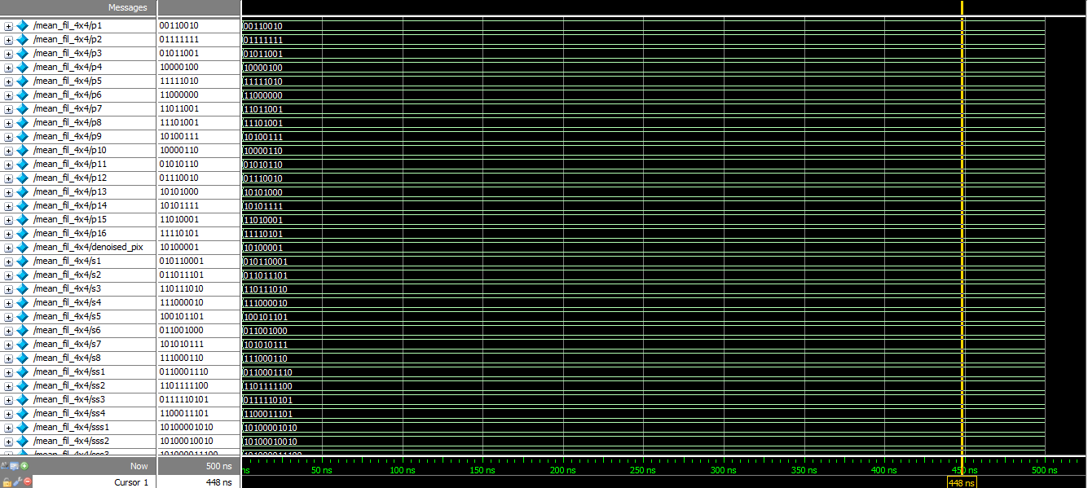
Output

Slide 10
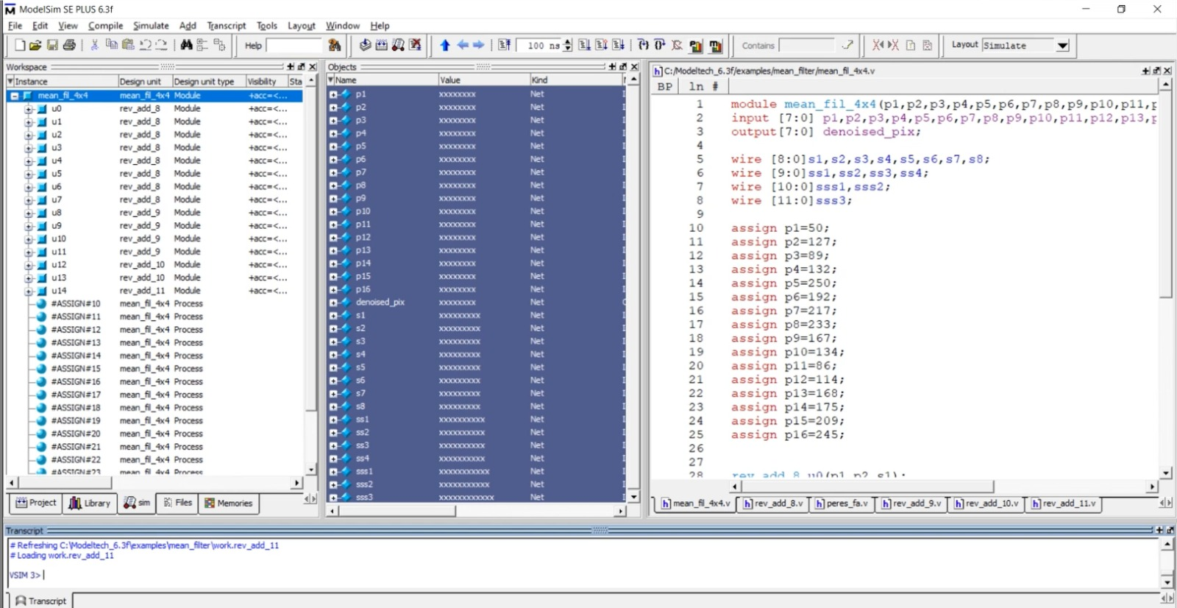

Slide 11
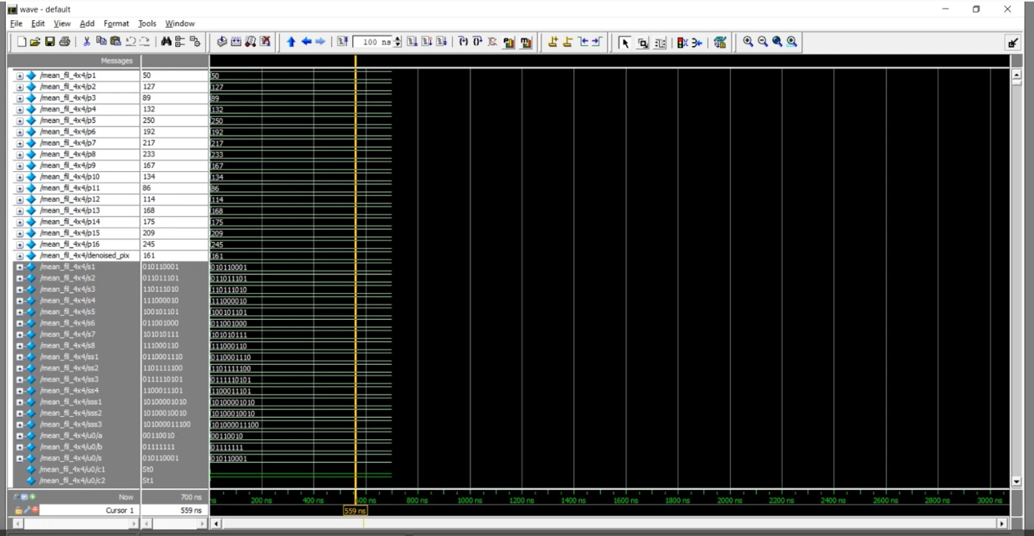

Slide 12
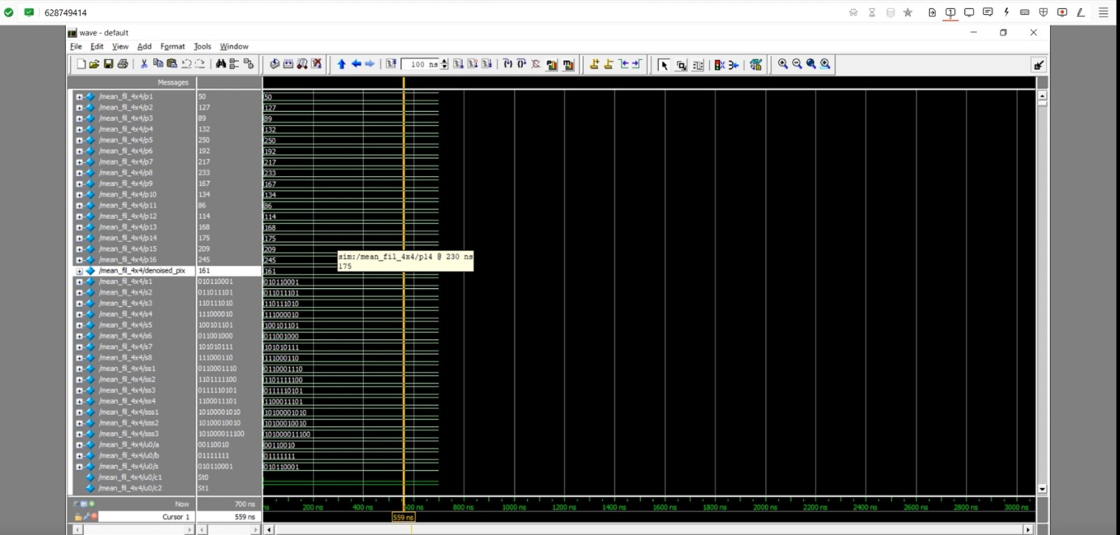

Slide 13
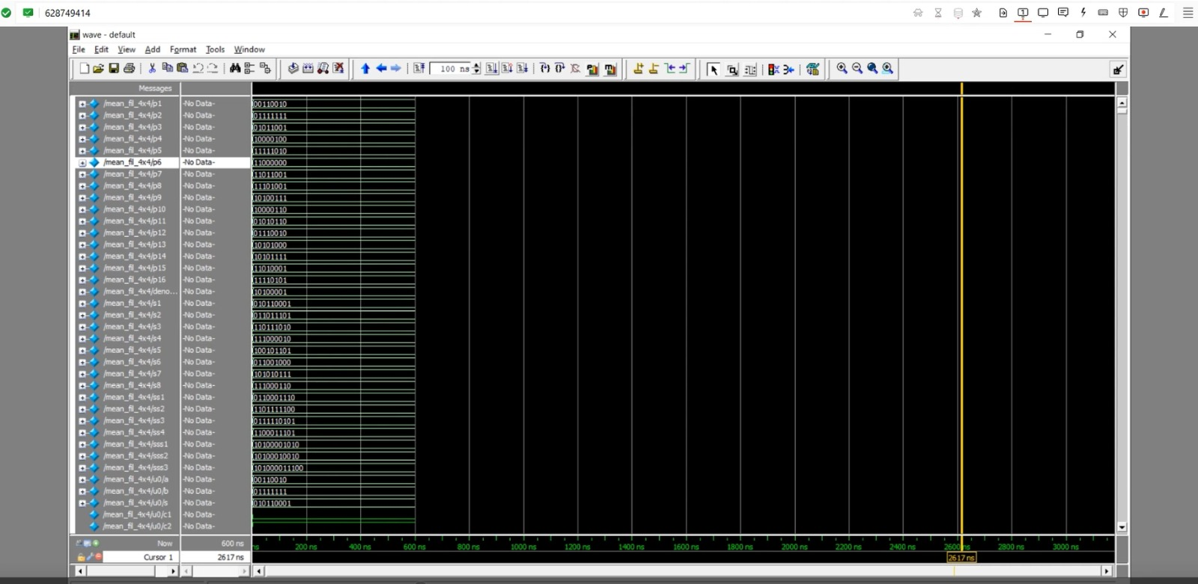

Slide 14
Proposed Methodology:
The VLSI-based hybrid ECG compression scheme addresses data storage and power challenges in long-term monitoring systems, employing a tailored lossless compression technique for ECG signals.
Hybrid Lossless Compression Algorithm : The methodology employs a hybrid compression algorithm, using Run-length coding and Golomb rice coding, to simplify consecutive data and compress low-entropy data effectively.
Implementation on MIT-BIH Arrhythmia Database: The compression algorithm undergoes validation on the widely used MIT-BIH arrhythmia database, ensuring its effectiveness and real-world applicability for ECG signal analysis.
VLSI Based Architecture: Implemented in 90nm CMOS technology, the compression algorithm optimizes VLSI architecture for space and power efficiency in wearable sensor nodes.
Performance Metrics: The VLSI-based architecture ensures minimal power consumption (18.78 µW) and compact size (0.0051 mm2), crucial for efficient and sustainable operation in wearable sensor nodes.

Slide 15

Conclusion:
The project introduces a hybrid approach combining VLSI techniques for ECG signal transformation and MATLAB-based 4x4 layer image compression, aiming to reduce noise, fluctuations, and improve SNR and MSE values, with a focus on Verilog HDL implementation on Xilinx Vertex-5 FPGA and comprehensive performance evaluation in terms of area, delay, and power characteristics.

Slide 16

Limitations
Compression Ratio: While the scheme achieves a compression ratio of 2.91 as per the implementation on the MIT-BIH arrhythmia database, the actual compression ratio in real-world applications with different data sets and conditions may vary.
Complexity and Power Consumption: Implementing a VLSI-based architecture for data compression can increase the complexity of the device and potentially its power consumption, depending on the specific implementation details and the hardware used.
Latency: The compression and decompression processes can introduce latency, which might be critical in real-time applications like ECG monitoring where timely data processing is essential.

